Slide 1
Discussion 8: Binary Trees
Christine Zhou

Slide 2
Agenda
Announcements
Tree Traversal Review
Worksheet #1
Worksheet #3
Worksheet #2 (If we have time)

Slide 3
Announcements
Congrats on finishing Project 1!
Midsemester survey will be released by Wednesday, and you’ll be given a week to complete it for extra credit!
HW 5 has been released
Due next Monday 10/22
Project 2 will be released sometime this week
Discussion survey: tinyurl.com/cz-disc8-fa18

Slide 4
Tree Traversals
When given a tree structure, we often want to visit all the nodes
Each node has a certain amount of children, today we’ll be working with binary trees
What order do we visit the nodes in?

Slide 5
Tree Traversals
Vary the order in which we visit ourselves and visit our children
Assuming binary tree
Preorder
process(self), visit(left), visit(right)
Inorder
visit(left), process(self), visit(right)
Postorder
visit(left), visit(right), process(self)

Slide 6
Tree Traversals
DFS
Search “depth first”, go as far down as you can before turning back
Fringe: Stack
BFS
Search “breadth first”, search the tree in layers
Fringe: Queue

Slide 7
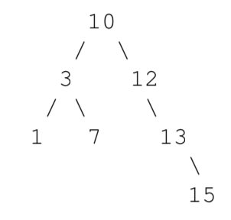
1 Law and Order

Slide 8
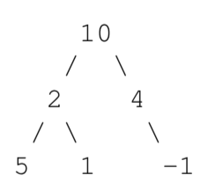
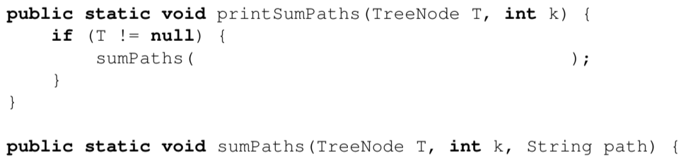
3 SumPaths
What is the worst case running time of the printSumPaths in terms of N, the number of nodes in the tree? What is the worst case running time in terms of h, the height of the tree?

Slide 9
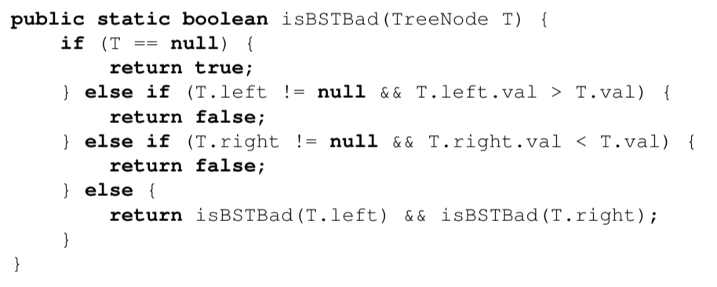
2 Is This a BST?

Slide 10
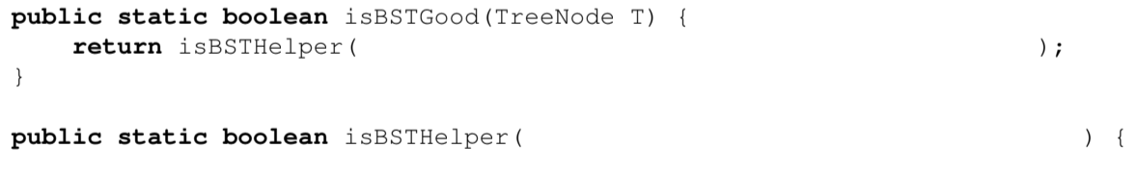
2 Is This a BST?

